Slide 1
Analysing the Characteristics of Neural Networks for the Recognition of Sugar Beets
Luca Brodo – Winter Semester 2021
Bachelor thesis and Project Work

Slide 2
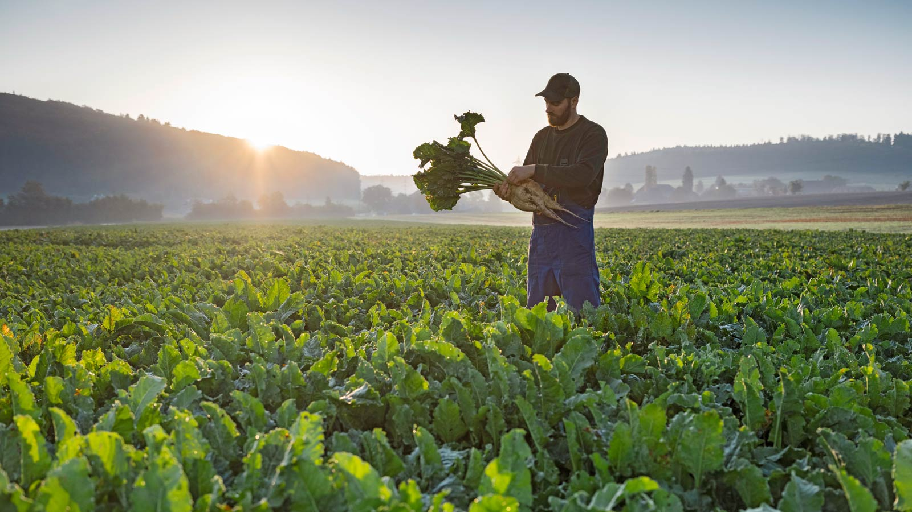
Why are we here?
(1)

Slide 3
Why are we here?
Empirically find correlations between the characteristics of Neural Networks in the settings of sugar beet recognition to be:
Precise
Scalable
Predictable in time

Slide 4
Why are we here?
The characteristics for recognition are the following:
How correct is the prediction?
Accuracy
How much training does the model require for predicting correctly?
Training time
How long does the model need for the prediction?
Inference time

Slide 5
Related work
In various researches, NN architectures are compared based on:
Accuracy achieved
Training time
Inference time
Various studies focus on the evaluation of NNs performances
Notes:
Project work

Slide 6
The problem
How is the weed managed in sugar beet plantations?
5 main weed management techniques:
Tillage
Crop rotation
Mechanical control
Herbicides
Novel automatic techniques
Notes:
Project work

Slide 7
The problem
Automatic weed management require the recognition of sugar beets and the weeds.
The recognition is done through images
A lot of variables
Notes:
Project work

Slide 8
The problem
Various possible data acquisition techniques
Various possible datasets
Two Detection approaches:
Plant-based classification
Weed mapping
Notes:
Project work

Slide 9
The problem
Various detection solutions:
Convolutional neural networks
CNNs as feature extractor for traditional classifiers
Fully convolutional neural networks
Different performances of the models
Notes:
Project work

Slide 10
What do we want to know?
Is inference time related to training time?
Is inference time related to accuracy?
Is the inference time related to the NNs structure?
Is inference time influenced by the attributes of the images? If so, do bigger images require more time to be processed?

Slide 11
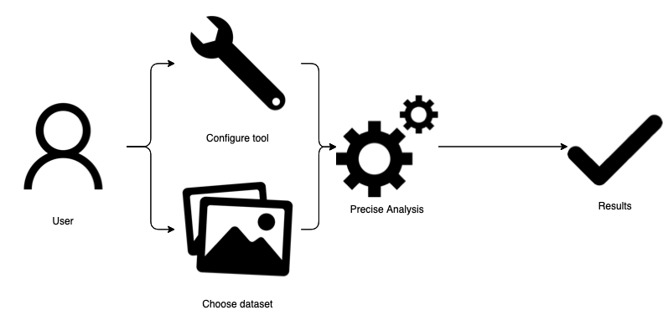
How can the models be analysed?

Slide 12
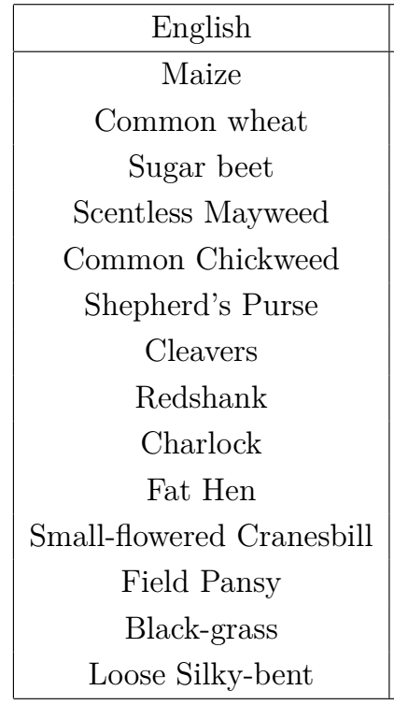
Use case
“Plants_seedlings_v2” dataset
~1000 images of seedlings of 12 species
10 pixels per mm

Slide 13
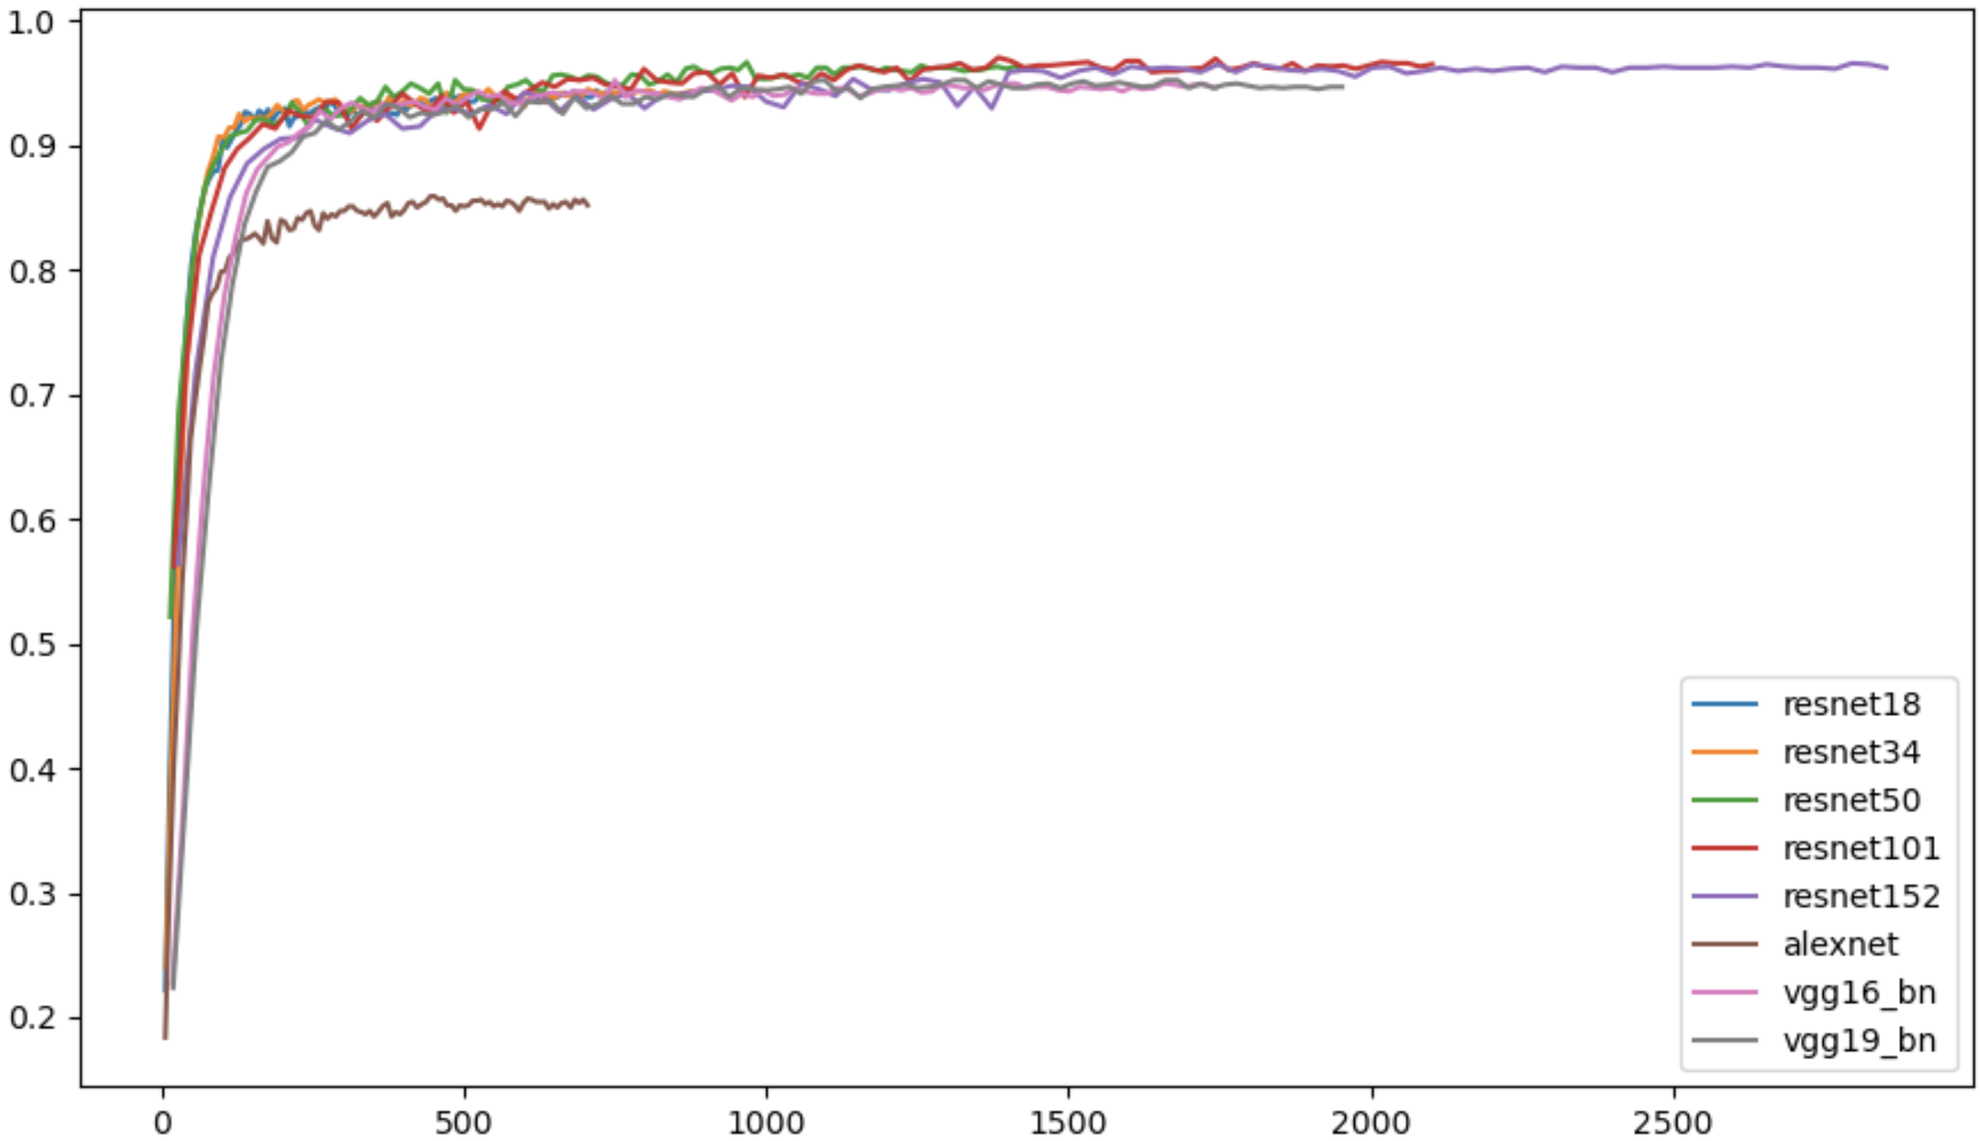
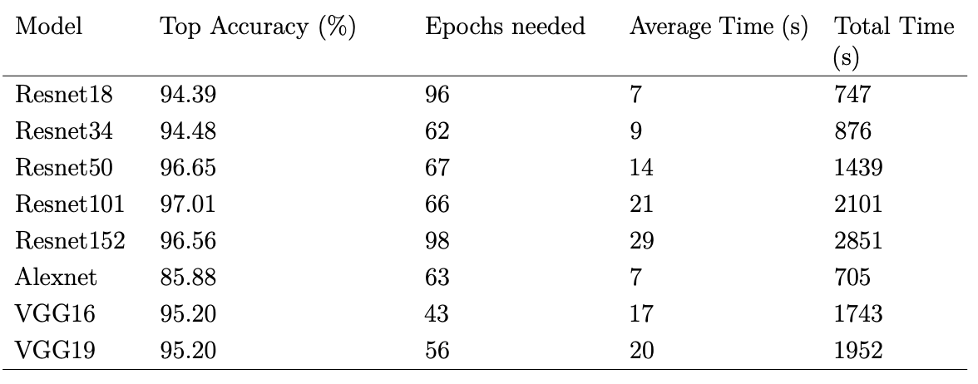
Training time
Accuracy
Time passed (s)

Slide 14
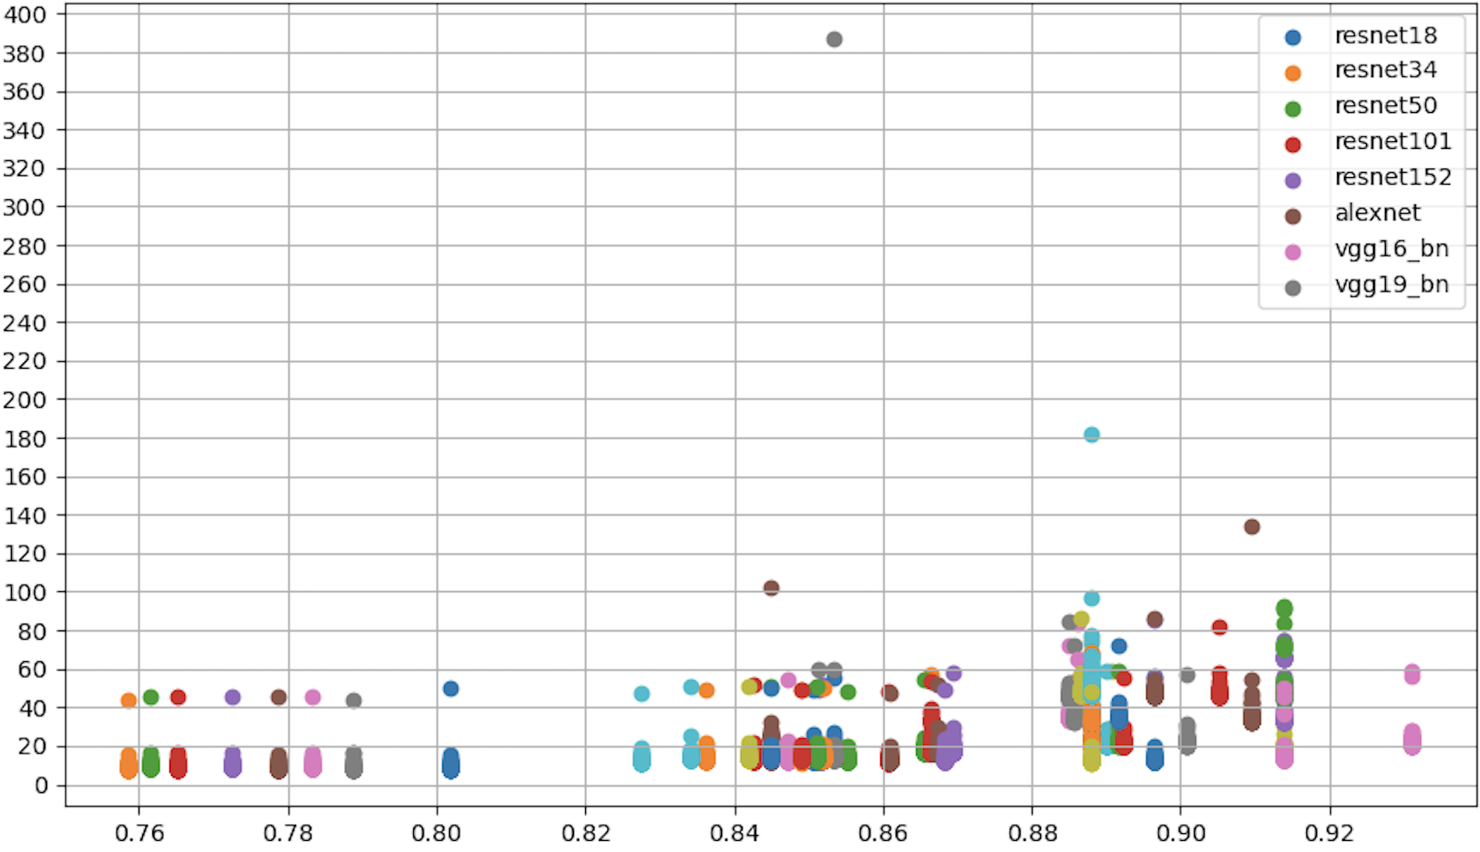
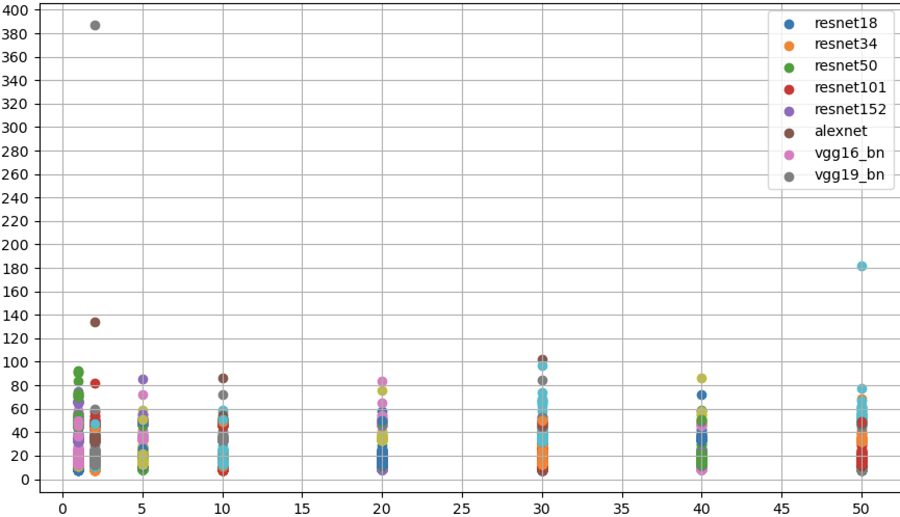
Inference time
Inference time (ms)
Accuracy
Epoch

Slide 15
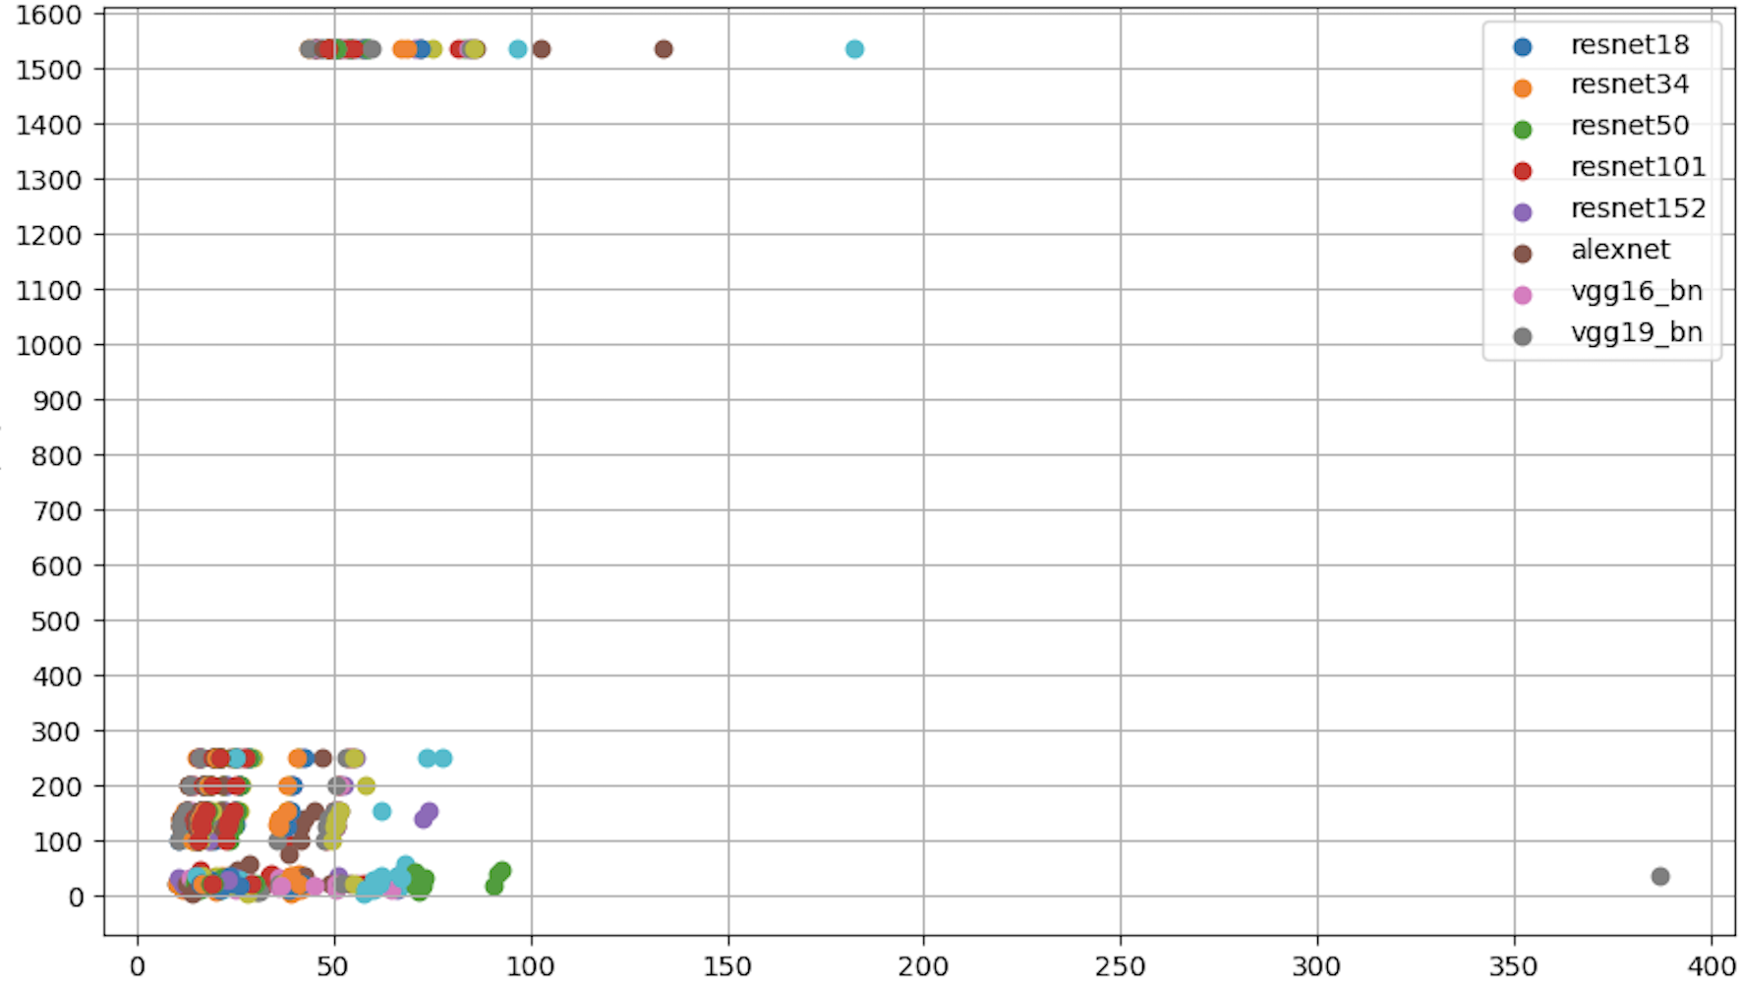
Size (kb)
Inference time

Slide 16
Overview
In recognition tasks, model perform differently.
The goal: find correlations between different characteristics of NN
How to find them? Precise Analysis

Slide 17
What else can we do?
Study input images
Finding characteristics of the images to use
Develop a tool to automatically study these characteristics
How can we optimize applications with this method?
Can we create contracts using these correlations?
First milestone to make sugar beet recognition more transparent

Slide 18
References
Swiss Sugar Ltd

Slide 19
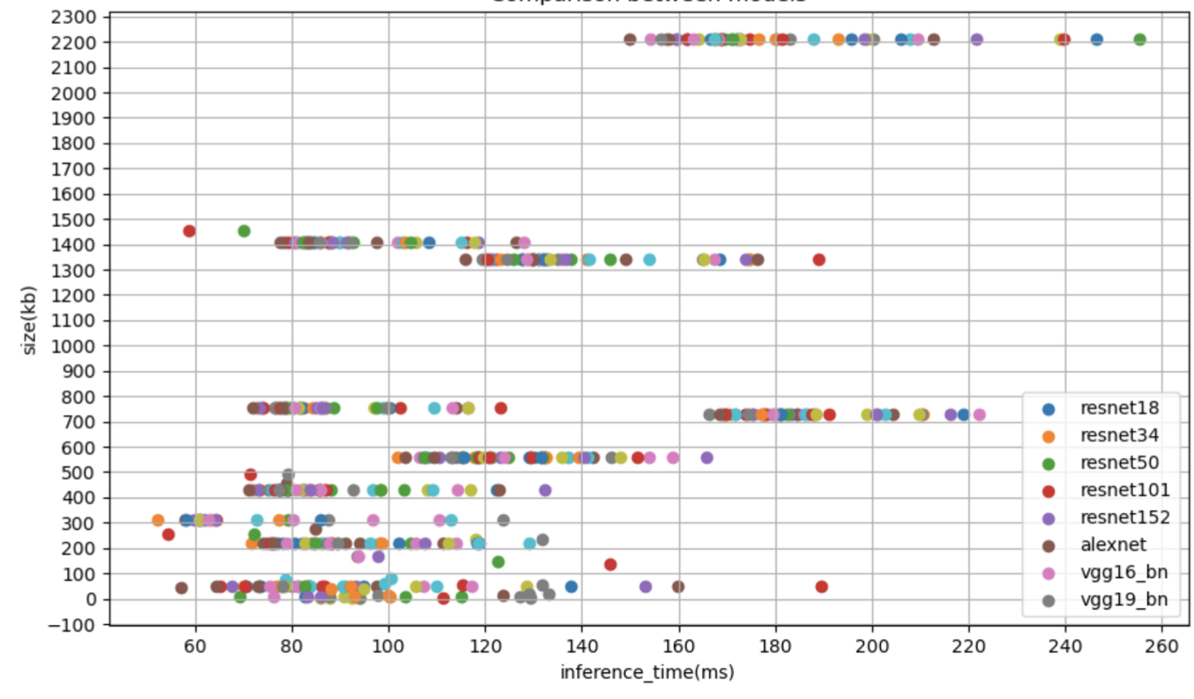

Slide 20
